Slide 1
Conditional Diffusion with Classifier Guidance
Jan Walliser, Sören Toschek

Slide 2
Overview
Problem statement
Reference paper: “Diffusion Models Beat GANs on Image Synthesis”
Classifier Guidance
Classifier Gradient Scaling
Training
Model architecture
CIFAR-10 Dataset
Results

Slide 3

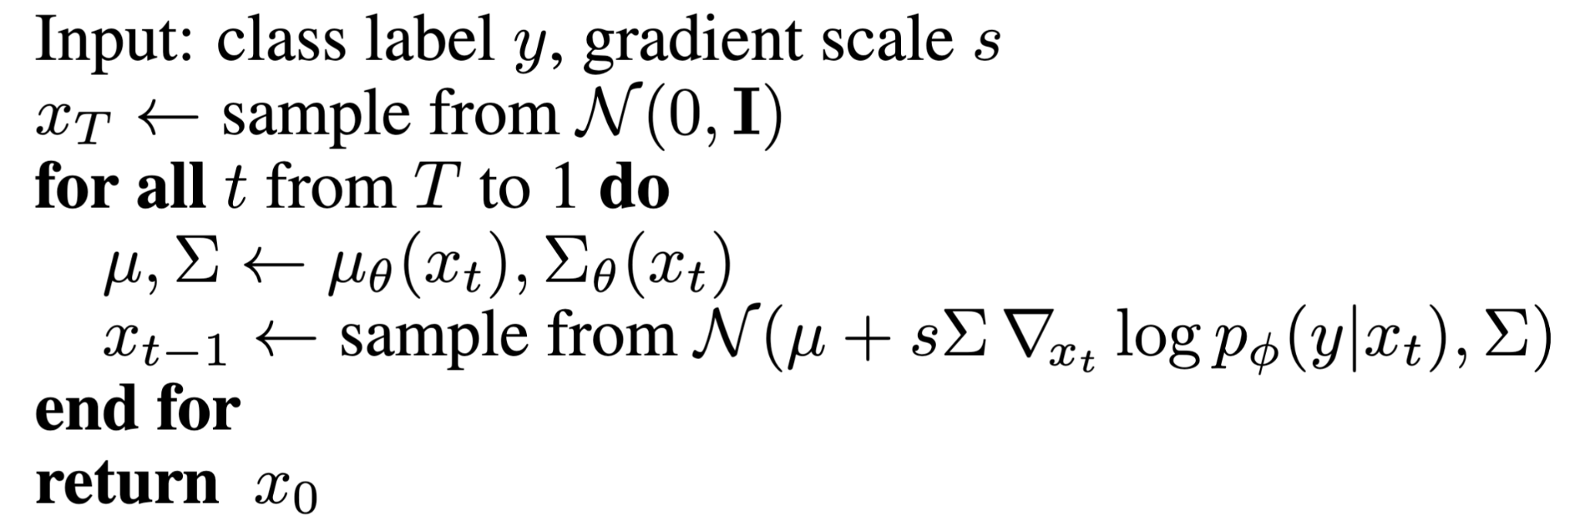
Classifier Guidance
classifier guidance is used during sampling
predicted mean is shifted towards gradients of classifier
I.e.

Slide 4

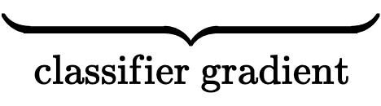
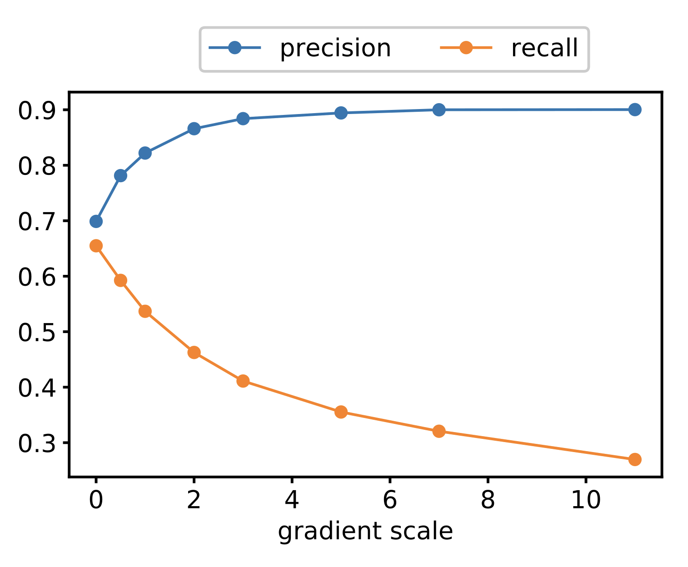
Classifier Gradient Scaling
Multiply gradient of the classifier network by a constant
stronger classifier guidance improves precision, and decreases recall

Slide 5
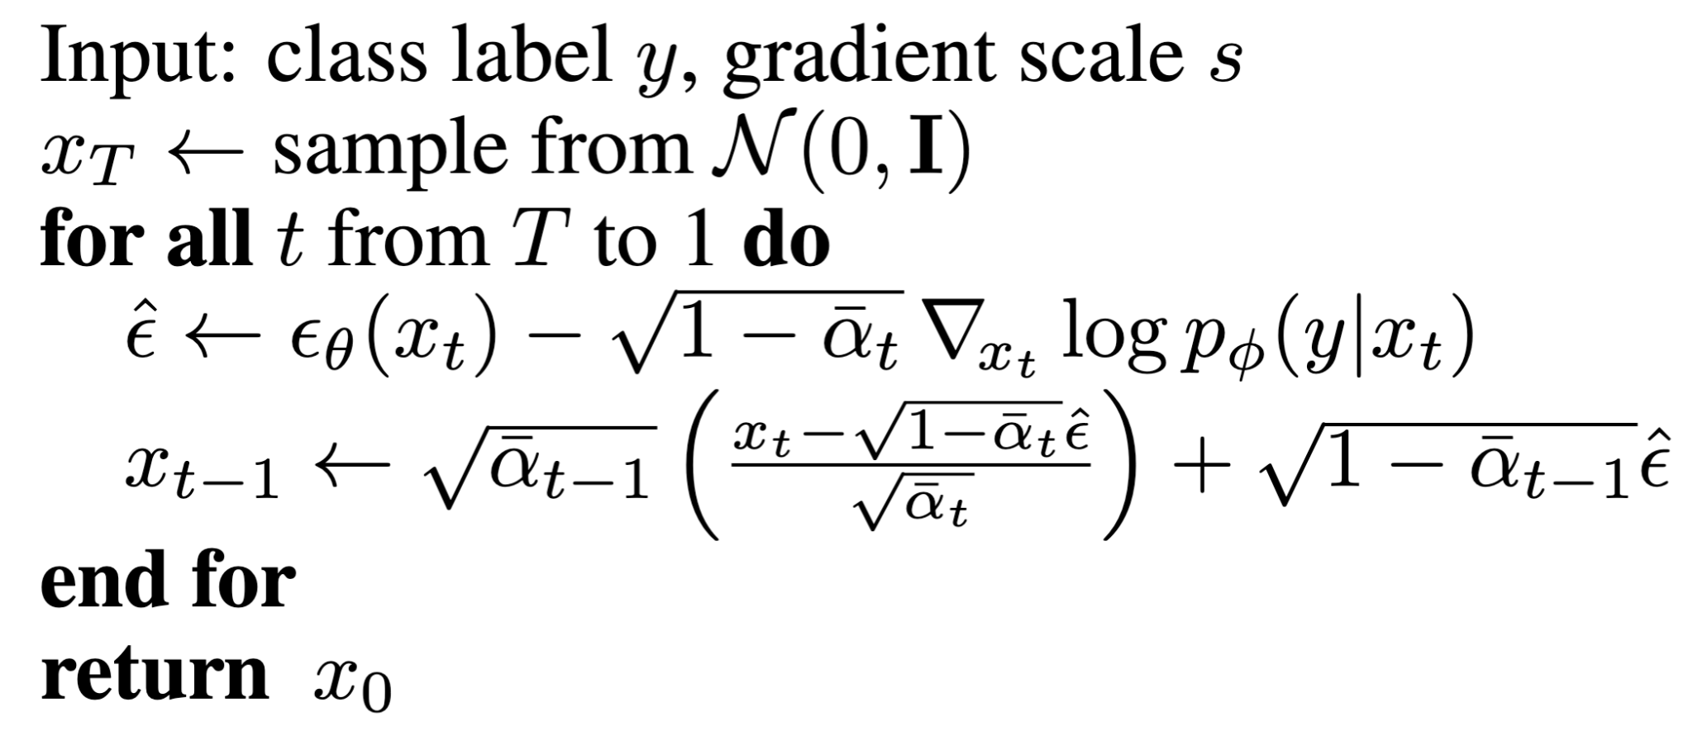
Diffusion Model Architecture

Slide 6

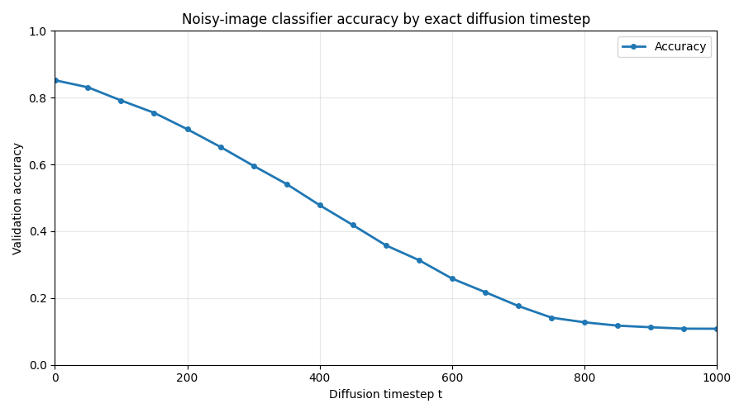
Training / training objective
Use MSE loss:
classifier: 30,480,010 parameters
diffusion-net: 41,412,771 parameters

Slide 7
Classifier architecture
UNet, residual convolutional layer
Classifier architecture:
CNN with skip connections with attention pooling at the end
Attention pooling on 16x16 and 8x8 resolution
map each

Slide 8
Results

Slide 9
Results

Slide 10
References

